Slide 1





STATISTICS AND PROBABILITY
Implementation in python
Presentation By
SANIA ARSHAD(098)
MALAIKA AROOJ(057)
EMAN WAHEED(027)
MARYAM(061)

Slide 2
Probability of events
PRESENTED BY:SANIA ARSHAD(098)

Slide 3
1. Introduction to Probability
Probability is a branch of mathematics that deals with the likelihood of different outcomes in uncertain situations. It provides a quantitative framework to evaluate how likely an event is to occur. Understanding probability is essential in various fields, including statistics, finance, science, and everyday decision-making.

Slide 4
Basic Concepts and Types of Probability
Event: A specific occurrence or outcome.
Sample Space: Set of all possible outcomes.
Probability: Number between 0 and 1 representing likelihood.
Types of Probability:
Theoretical Probability (based on theory).
Experimental Probability (based on data).
Conditional Probability (dependent events).

Slide 5
EXAMPLE
Example 1: A random card is drawn from a deck of 52 cards. What is the probability that it is an ace? Solution: E = event of drawing an ace. Total number of outcomes = 52 The favorable number of outcomes = 4 (there are 4 ace cards in a deck of cards. One belonging to each suit). P(E) = 4 / 52 = 1 / 13 Answer: P(E) = 1 / 13
Example 2: On rolling a fair dice, A is the event of getting a number less than 5, B is the event of getting an odd number and C is the event of getting a multiple of 3. Find the AND event. Solution: Sample space of a dice roll = {1, 2, 3, 4, 5, 6} A = {1, 2, 3, 4} B = {1, 3, 5} C = {3, 6} A ∩ B ∩ C = {3} Answer: A ∩ B ∩ C = {3}

Slide 6
Probability Rules and Real-World Applications
Addition Rule: P(A or B) = P(A) + P(B).
Multiplication Rule: P(A and B) = P(A) × P(B).
Complement Rule: P(A') = 1 - P(A)
Real-World Applications:
Insurance.
Finance.
Medicine.
Engineering.

Slide 7
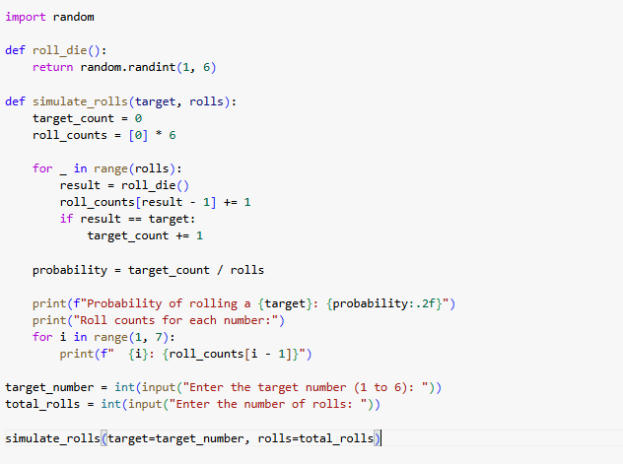
Code Example:

Slide 8
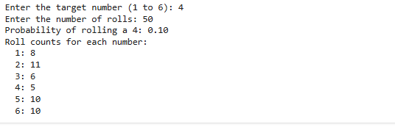
OUTPUT

Slide 9
Conditional Probability
PRESENTED BY: MALAIKA AROOJ(057)

Slide 10
Students will be able to: find the conditional probability of an event.
Key Vocabulary:
Independent events
Dependent events
Conditional Probability

Slide 11
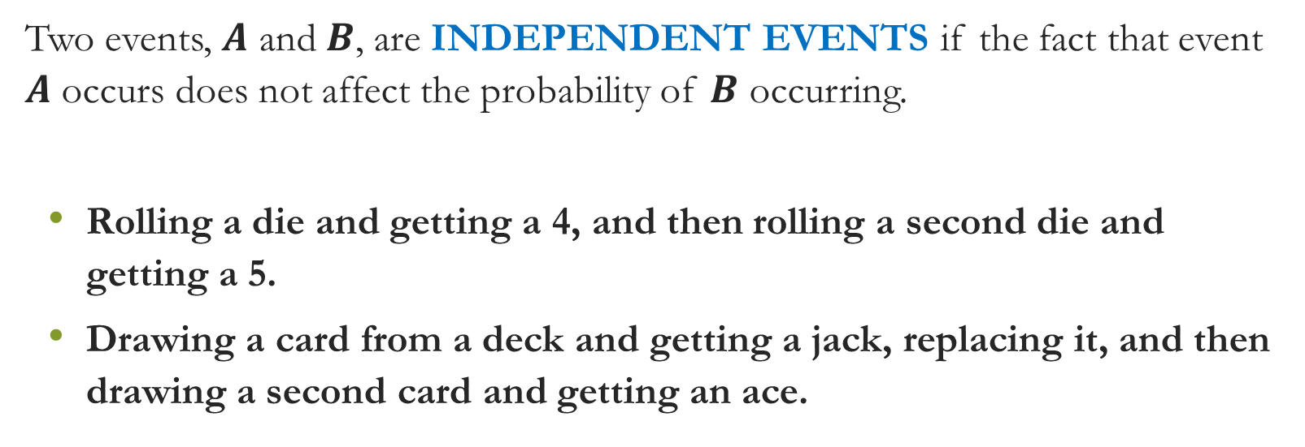
INDEPENDENT EVENTS

Slide 12
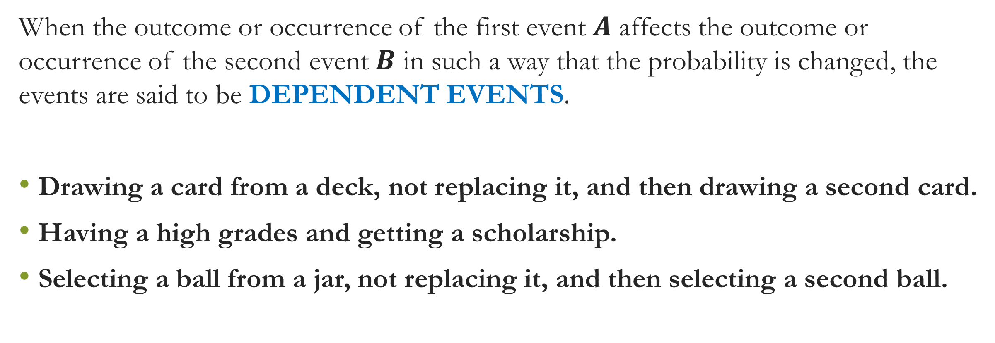
DEPENDENT EVENTS.

Slide 13
Conditional Probability
A CONDITIONAL PROBABILITY of an event is used when the probability is affected by the knowledge of other circumstances. It can only occur to dependent events.

Slide 14
Types of Events
Conditional Probability

Slide 15
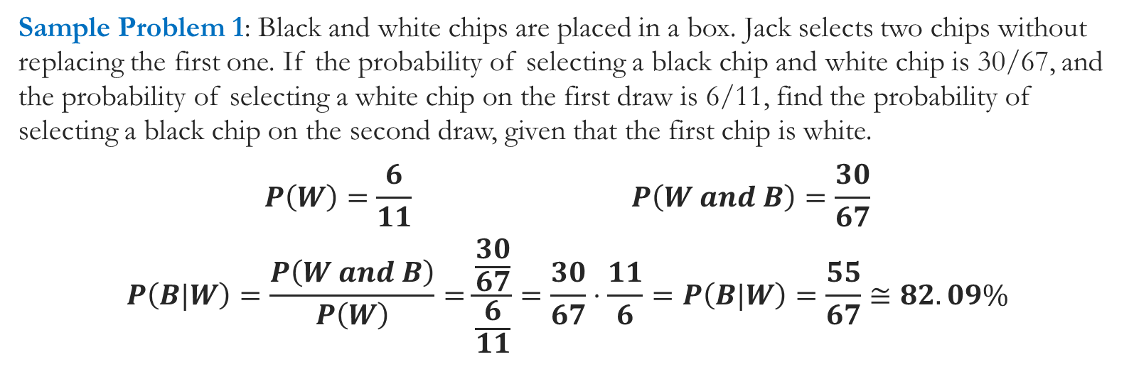
Sample Problem 1

Slide 16
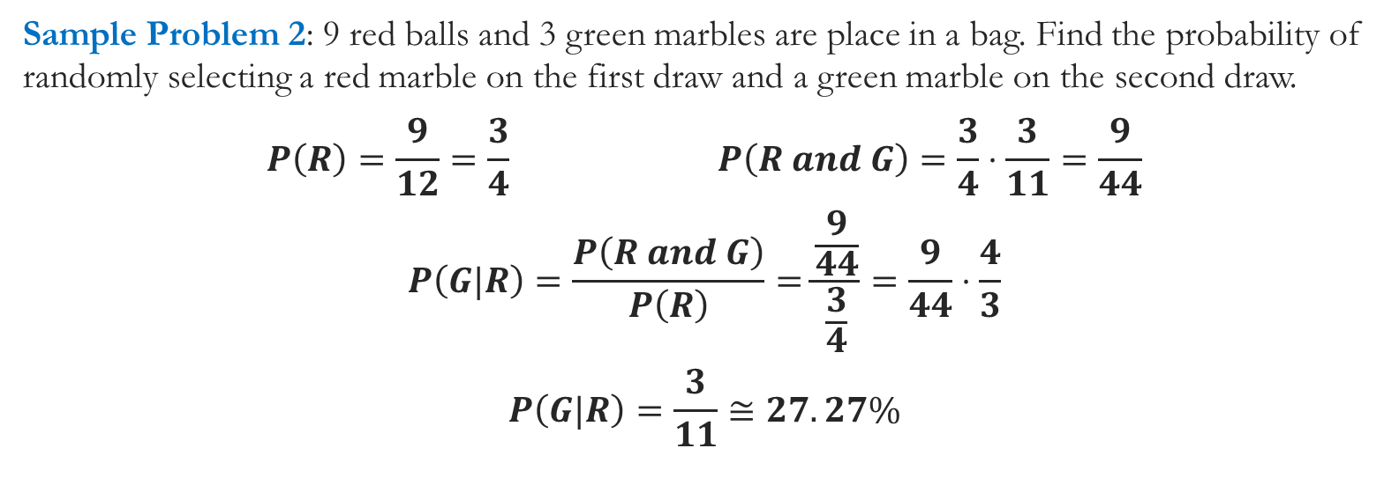
Sample Problem 2

Slide 17
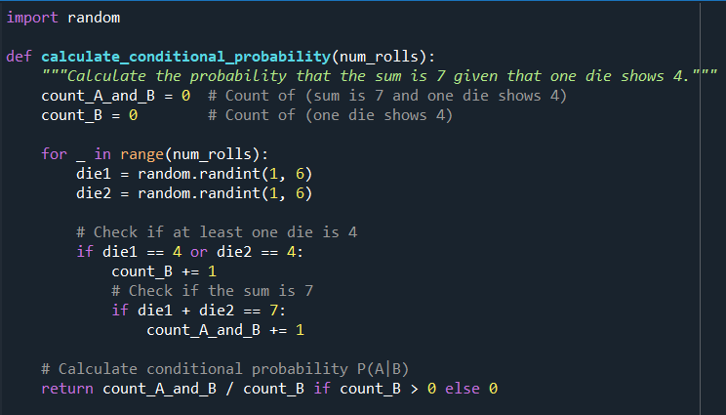
Code Example:
Let’s say we want to calculate the conditional probability of getting a sum of 7 given that at least one die shows a 4. This would mean:
Event A: The sum of two dice is 7.
Event B: At least one die shows a 4.
To calculate P(A∣B)P(A|B)P(A∣B), we need:
P(A∩B)P(A \cap B)P(A∩B) – Probability of both events (sum is 7 and one die shows 4).
P(B)P(B)P(B) – Probability that at least one die shows a 4.

Slide 18
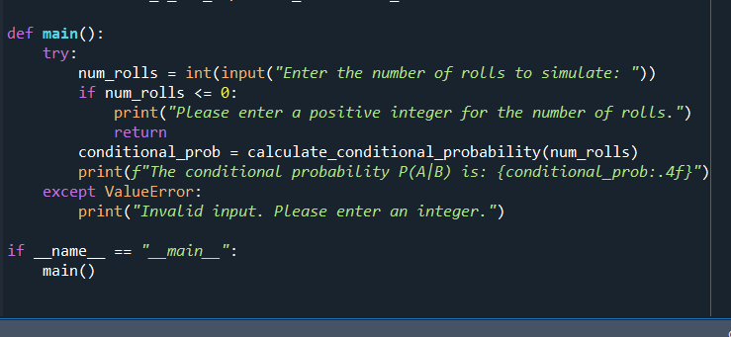
Code Example:
roll_dice(): Simulates rolling two dice.
simulate_rolls(): Rolls dice multiple times.
event_a_and_b(): Counts occurrences of A∩BA \cap BA∩B.
event_b(): Counts occurrences of event B.
calculate_conditional_probability():
Computes conditional probability P(A∣B)P(A|B)P(A∣B).
main(): Runs the program logic.

Slide 19
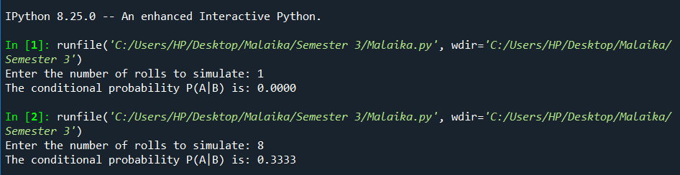
OUTPUT:

Slide 20
INDEPENDENT EVENTS
PRESENTED BY:
EMAN WAHEED(027)

Slide 21

Independence in Statistics and Probability:
1. Definition of Independence
Statistical Independence: Two events A and B are independent if the occurrence of one does not affect the occurrence of the other.
Example: Consider flipping a fair coin twice. The result of the first flip (heads or tails) does not affect the result of the second flip. In this case, the two events (first flip and second flip) are statistically independent.

Slide 22
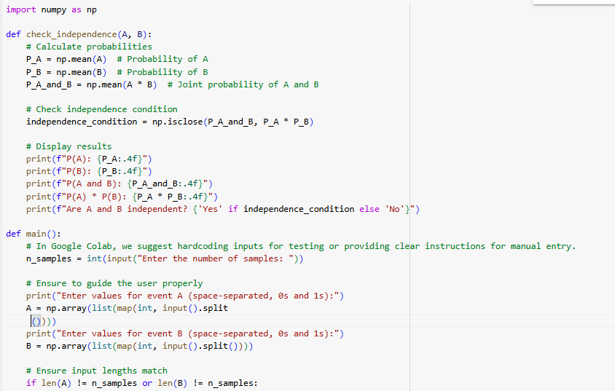
SOURCE CODE IN PYTHON:

Slide 23
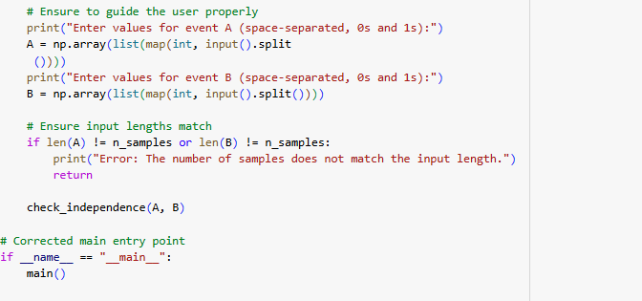

Slide 24
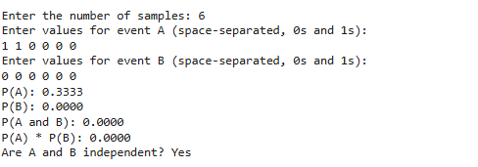
OUTPUT: WHEN IT IS INDEPENDENT

Slide 25
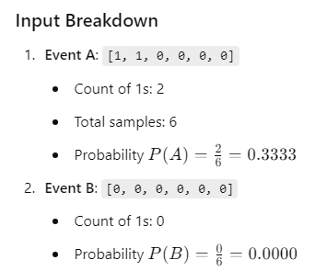
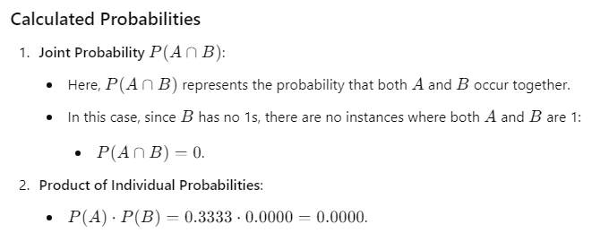
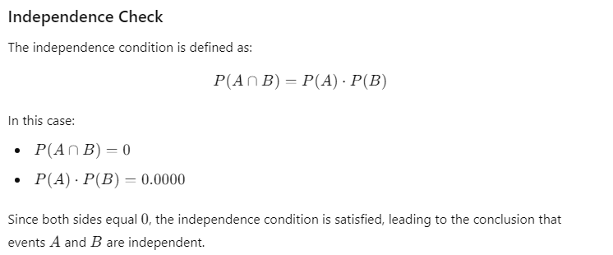

Slide 26
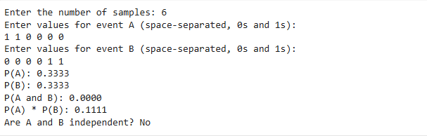
OUTPUT:WHEN IT IS DEPENDENT

Slide 27
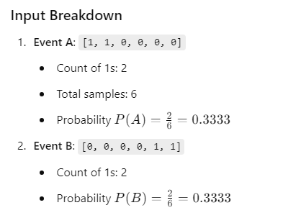
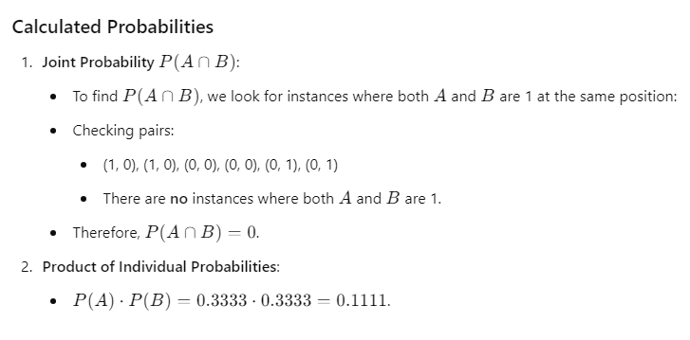
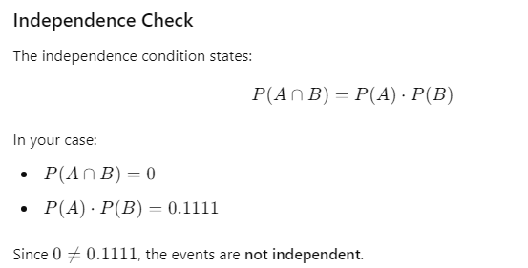

Slide 28
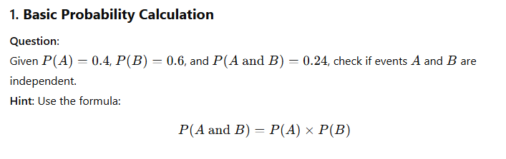
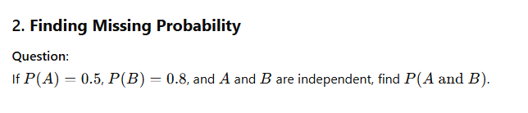

Slide 29
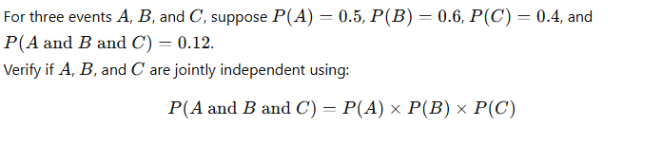

Slide 30

Random Variables
PRESENTED BY:MARYAM(061)

Slide 31


TABLE OF CONTENT
“RANDOM VARIABLE”
“TYPES OF RANDOM VARIABLE”
“EXAMPLES”:
THEORY BASED
PYTHON CODE BASED

Slide 32


Slide 33
1. What is a Random Variable?
“A random variable is a numerical outcome of a random process or experiment. It assigns real numbers to every possible outcome of a random phenomenon.”
OR
“A function from a sample space to the real numbers.”
Essential for ‘understanding probability’, ‘uncertainty’, and ‘statistical models’.

Slide 34

OF RANDOM VARIABLE
Discrete Random Variables
Can take only specific, countable values.
Example: Number of heads in 10 coin tosses.
Continuous Random Variables
Can take any value in a range.
Example: Time taken for a car to complete a race.

Slide 35


Slide 36

Example of Discrete Random Variable
Example: Rolling a Fair Die
Random Variable (X): Outcome of rolling a six-sided die.
Possible outcomes: X={1,2,3,4,5,6}
Probability Distribution (PMF): All outcomes have an equal probability of 1/6

Slide 37

Example of Continuous Random Variable
Example: Time to Wait for a Bus
Random Variable (Y): The time (in minutes) you wait
for the bus.
Possible outcomes: Y=[0,∞) , Y = [0, infinity)
Probability Distribution (PDF): The probabilities are distributed over a continuous interval.

Slide 38

Mathematical Properties of Random Variables
Expected Value (E[X]): The weighted average of all possible values:
FOR DISCRETE:
E[X]=∑ xi . ​P(X=xi​) or
FOR CONTINUOUS:
E[X]=∫−∞∞​ x fX​(x)dx (Continuous)

Slide 39

Applications of Random Variables
Insurance:
Random variables like life expectancy and accident probabilities help calculate insurance premiums.
Finance:
Stock price changes, portfolio returns, and risks are modeled using random variables.
Weather Forecasting:
Predicting the temperature, precipitation, and storm likelihood uses random variables to model uncertainty.
Gaming:
Dice rolls, card shuffling, and random number generation are all modeled using discrete random variables.

Slide 40


Python Code Example: Discrete Random Variable
Lets Consider a Code Example in Python language to calculate mean and variance and then plot the PMF which is shown as graph.

Slide 41

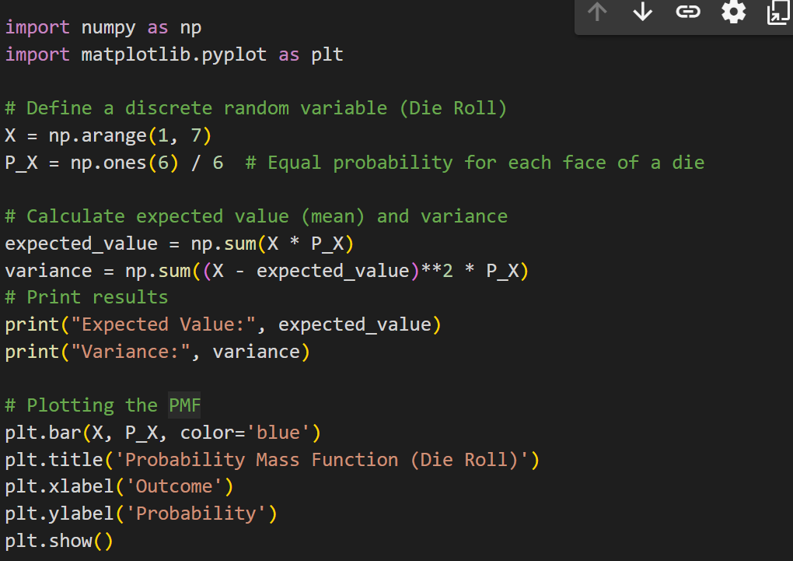

Slide 42



Slide 43

WHAT WE DID IN OUR CODE?
Imported Libraries:
🡪Imported numpy for numerical operations.
🡪Imported matplotlib.pyplot for plotting.
Defined a Discrete Random Variable:
🡪Represented a die roll with outcomes from 1 to 6 (X).
🡪Assigned equal probabilities (P_X) for each outcome, representing a fair die.
Calculated Expected Value and Variance:
🡪Computed the expected value (mean) of the die roll.
🡪Calculated the variance to measure the spread of outcomes.
Printed Results:
🡪Displayed the expected value and variance in the output.
Plotted the Probability Mass Function (PMF):
🡪Created a bar chart showing the probabilities of each die roll outcome.

Slide 44
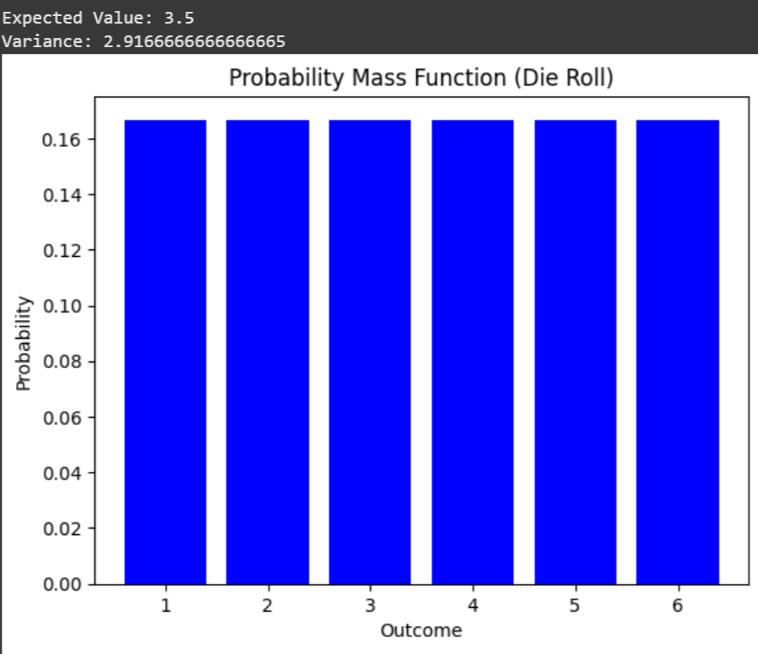
OUTPUT OF OUR CODE
Expected Value:
3.5
Variance:
2.92

Slide 45


